Slide 1
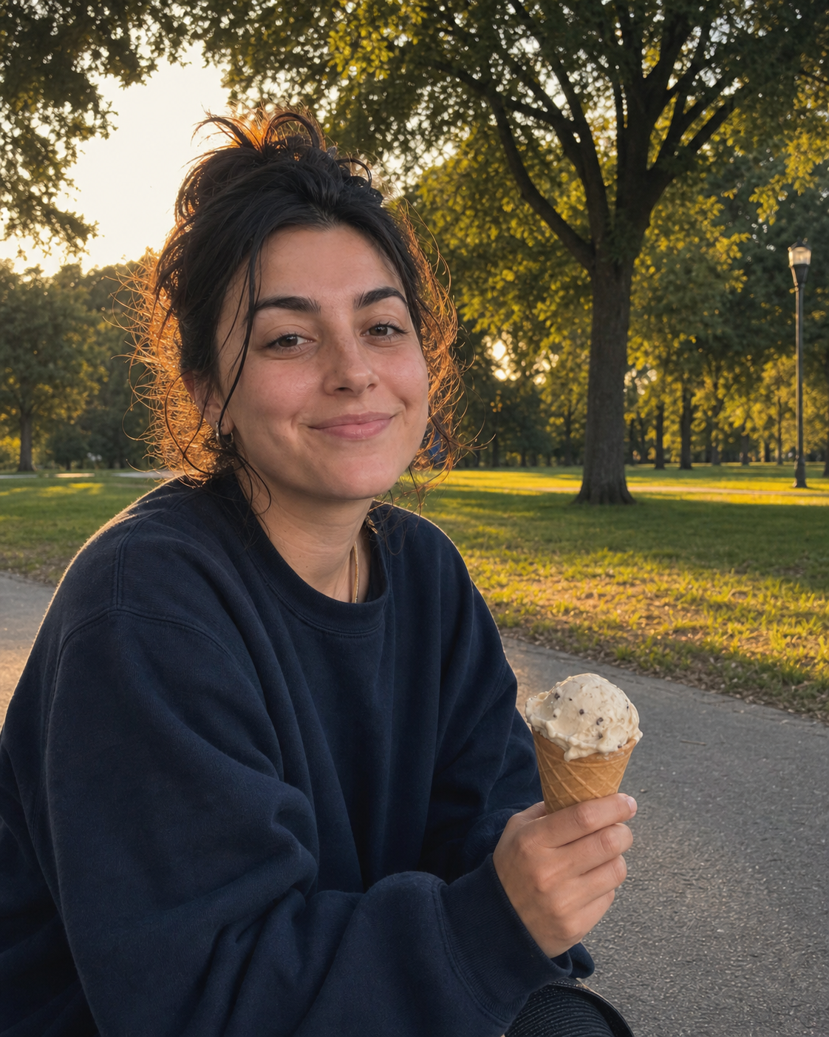
CAMERA ROLL DUMP · 01
little treats
big feelings
the small moments that made the whole week feel softer
a few things from lately ♡
01

Slide 2
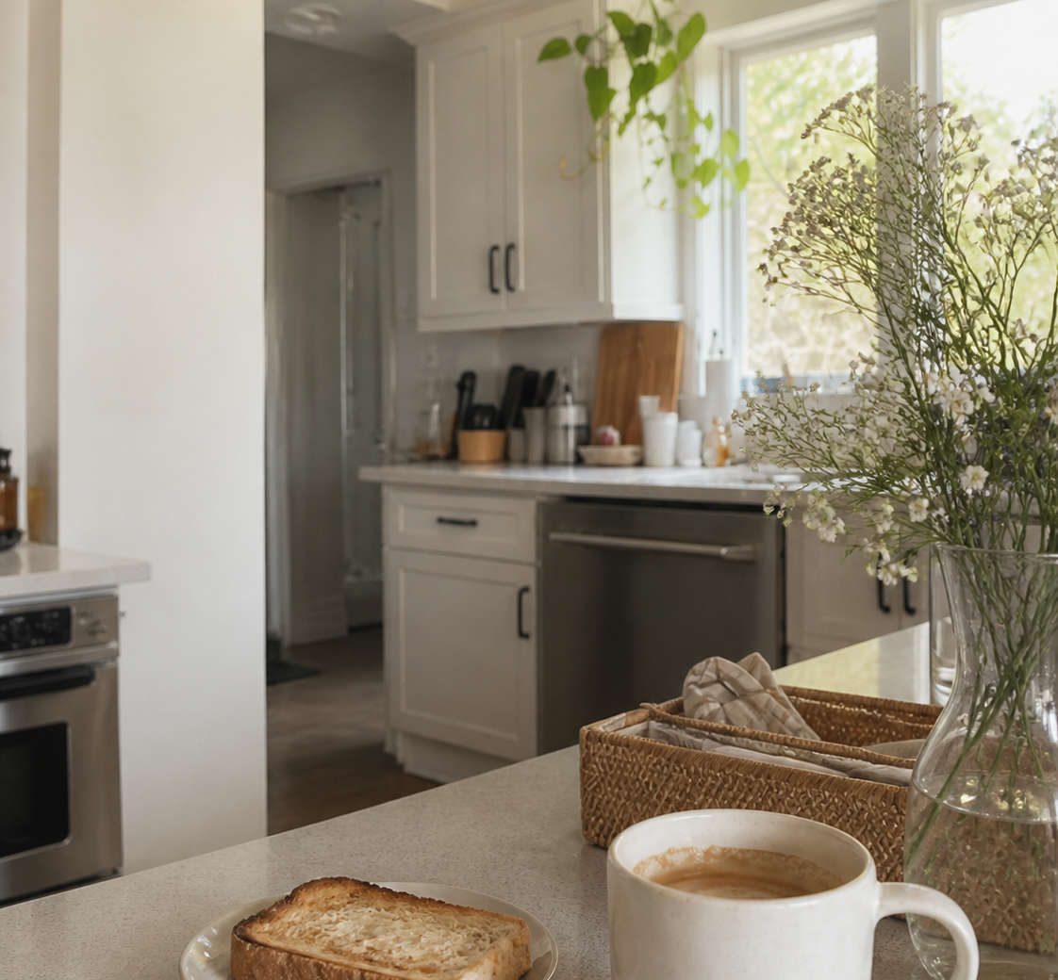
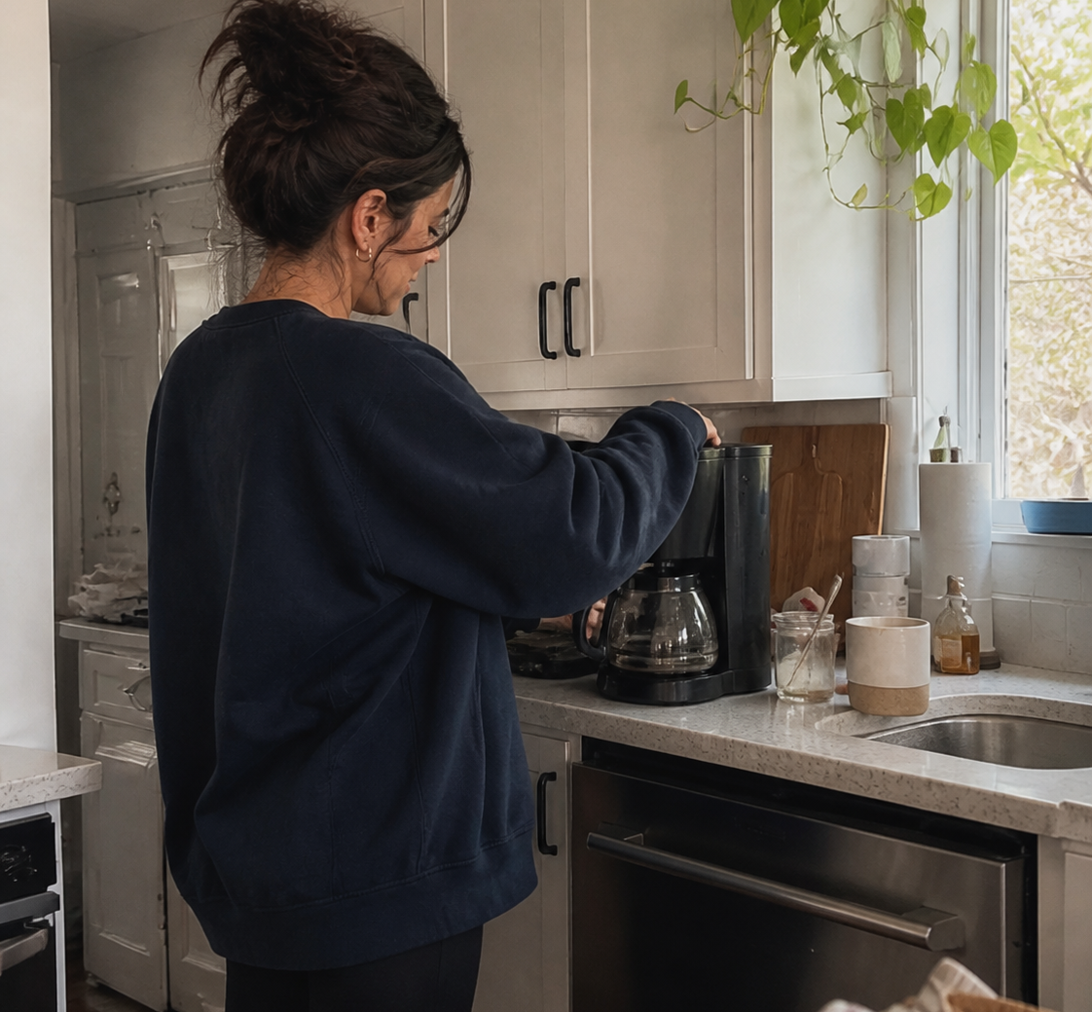


A FEW FRAMES · 02
the good
parts
02

Slide 3

MICRO CELEBRATIONS · 03
tiny wins
this week
→
fresh sheets
→
an iced coffee outside
→
a walk after dinner
nothing huge just good ✦
03

Slide 4

FOR NOW · 04
that’s the
roll
i’ll be back with more little things worth keeping
same time next week →
04

